Slide 1


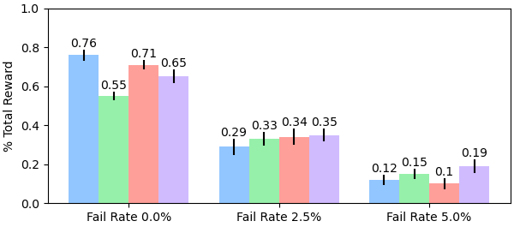
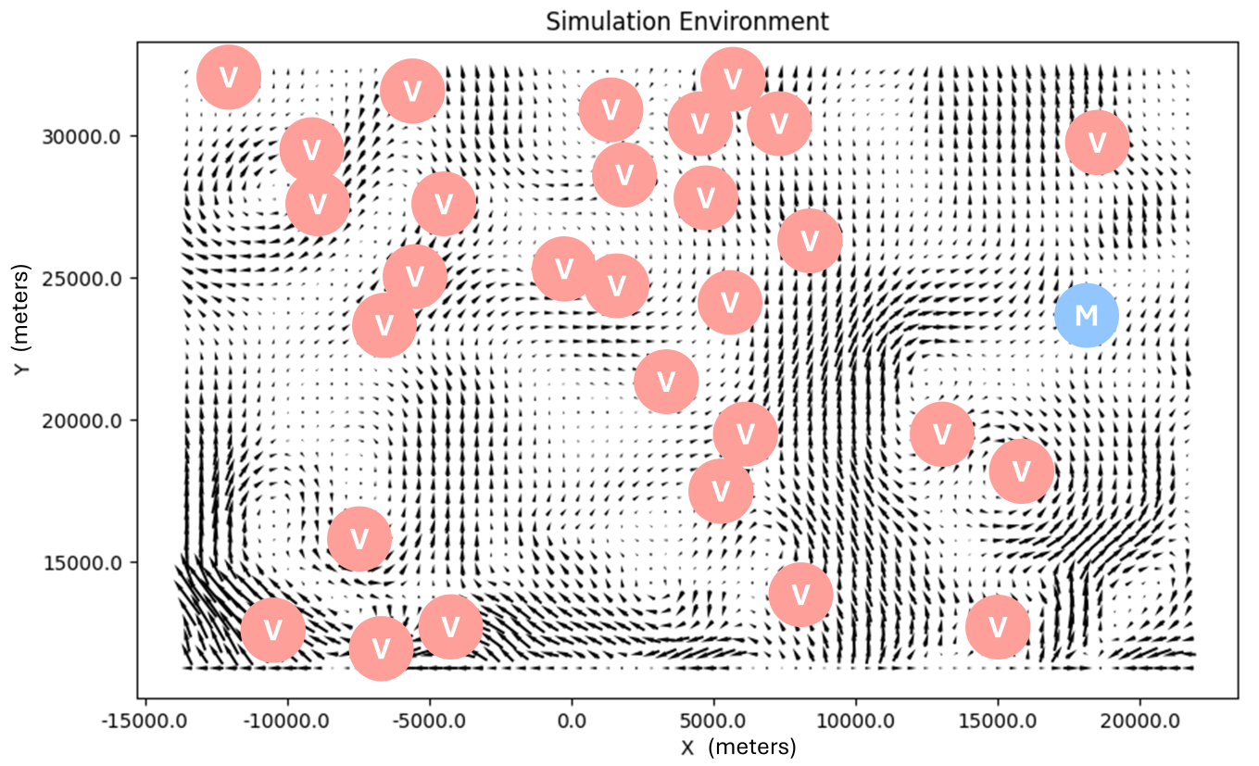
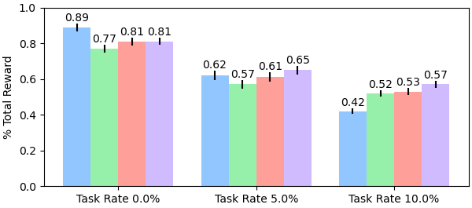


NSF Award
#2322055
Hybrid Decentralization for Multi-Robot Orienteering with Mothership-Passenger Systems
Nathan L. Butler and Geoffrey A. Hollinger
Collaborative Robotics and Intelligent Systems (CoRIS) Institute, Oregon State University
Experiment setup notes setup notes setup notes setup notes setup notes setup notes
Experiment setup notes setup notes setup notes
Experiment setup notes setup notes setup notes
Experiment setup notes setup notes setup notes
Experiment setup notes setup notes setup notes
Experiment setup notes setup notes setup notes
Experiment setup notes setup notes setup notes
Hybrid Decentralized Mission Planning
Initial, high-level motivating text
Experiments and Results
Experiment setup notes setup notes setup notes setup notes setup notes setup notes
Experiment setup notes setup notes setup notes
Experiment setup notes setup notes setup notes
Experiment setup notes setup notes setup notes setup notes setup notes setup notes
Experiment setup notes setup notes setup notes
Experiment setup notes setup notes setup notes
Experiment setup notes setup notes setup notes
Experiment setup notes setup notes setup notes
Experiment setup notes setup notes setup notes
Experiment setup notes setup notes setup notes
3 Robots, 30 Tasks
6 Robots, 20 Tasks
Takeaways
butlnath@oregonstate.edu
natbut.github.io
QR TO WEBSITE PAPER

